Slide 1
REDZ TRACKER APPLICATION
Rachael Okuwa • Emma Benkő
Dorina Majoros • Zsombor Pálfi

Slide 2
Understanding the project
Objective:
define a minimum viable product
create clearly defined roles
deliver a web application to view, buy and sell shares
Purpose of the project:
learn how to work in a team
understand the lifecycle of developing a project
strenghten problem-solving and communication skills

Slide 3
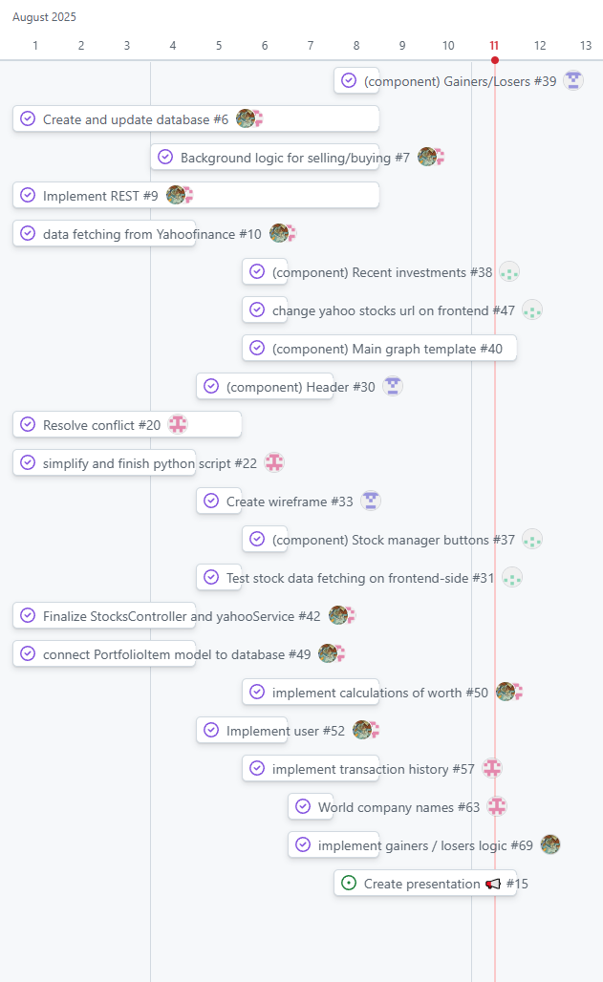
Project management
Decisions made as a group
GitHub Project boards with issues
Personal branches
Separate pairs for frontend & backend
Instant feedback between pairs
Pair programming, constant check-ins

Slide 4
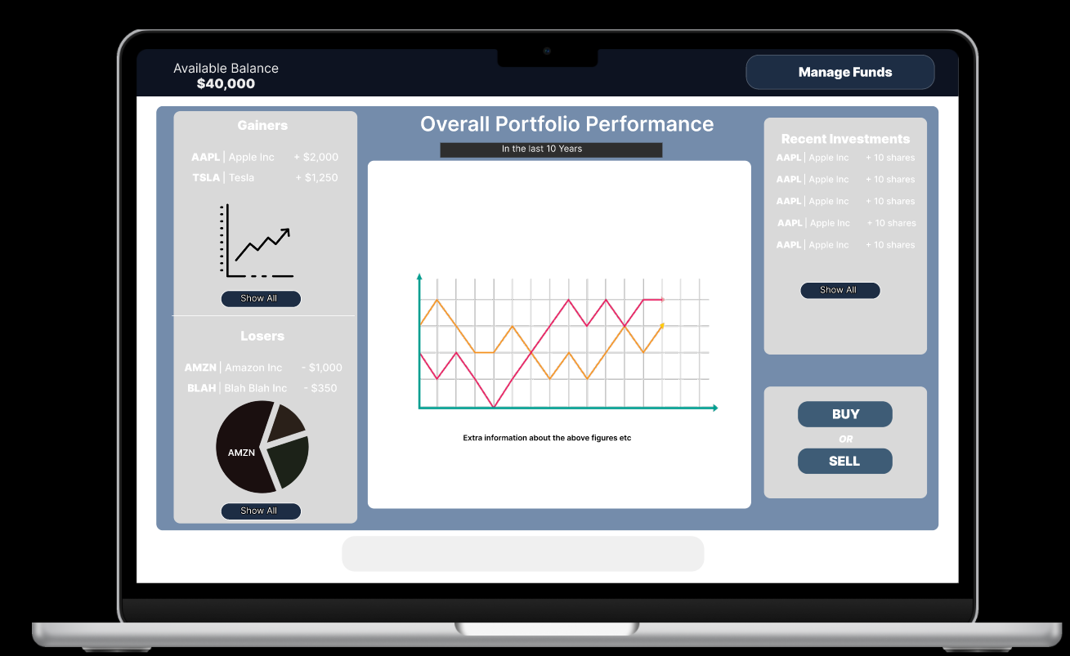
Outcomes - Minimum Viable Product

Slide 5
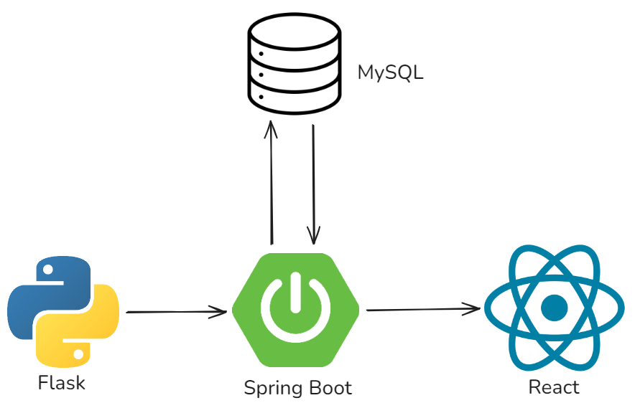
Architecture

Slide 6
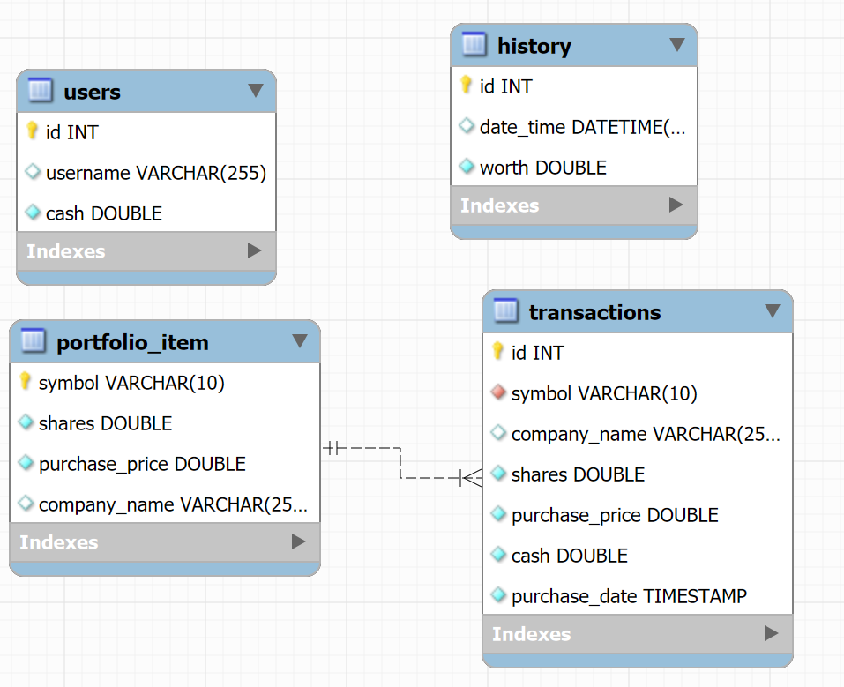
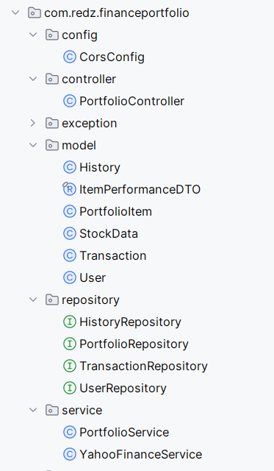
Data model

Slide 7
DEMO

Slide 8
Next steps
If we had more time:
Handling multiple users
If we could start over:
Start the frontend implementation sooner
Settle database design sooner

Slide 9

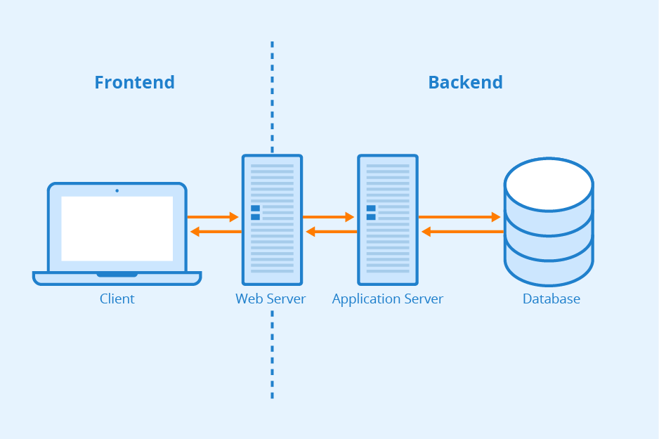
Challenges

Slide 10
THANK YOU ☺

